Slide 1

Cryptocurrency Price Prediction
Presented By:
Manuel Cervantes,
Ankita Gautam,
Stephen Lane,
Lorena Martinez,
Joel Navarro

Slide 2

Cryptocurrency is…
Digital money exchange process
Secured by cryptography
Vetted by blockchain technology
Decentralized
Tax free
Not insured
Banned in many countries
Capable of being converted to cash using crypto exchange (i.e. coinbase)

Slide 3

Bitcoin
Developed in 2008 by pseudonymous Satoshi Nakamoto
First cryptocurrency
Established in 2009 when first block chain was mined
Network is maintained by people (miners) all over the world who verify transactions
https://bitcoin.org

Slide 4

Ethereum
Created in 2013 by Programmer Vitalik Buterin
Platform uses smart contracts
Mining works by having users solve computational problems
Builds on bitcoin’s innovation, making it a programmable blockchain
It’s a marketplace of financial services, games and apps
https://ethereum.org/en/

Slide 5

Dogecoin
Forked from Litecoin in 2013
Created by software engineers Billy Markus and Jackson Palmers as a “joke” payment system
Shiba Inu “Doge” is the mascot
Considered both the first “meme coin” and “dog coin”
Primarily used for “tipping” quality content on forums like Reddit
Mined using consumer-grade computers
Frequently experiences price movements shortly after tweets from Elon Musk
https://dogecoin.com/

Slide 6

Visualization
Created a story using tableau, displaying forecast analysis of bitcoin and Ethereum market cap.
Also displaying the volume (number of times a coin is traded in the market) from lowest to highest.
https://public.tableau.com/views/CryptoAnalysis_16472230674920/Story1?:language=en-US&publish=yes&:display_count=n&:origin=viz_share_link

Slide 7



Approach
Machine Learning
Logistic Regression Model
Random Forest Classifier
Deep Learning
Long Short-Term Memory
Tensorflow Keras

Slide 8
Long Short-Term Memory (LSTM)
Long Short-Term Memory (LSTM) – extension of Recurrent Neural Network (RNN)
LSTM networks process the current input by taking in consideration the previous output.
Main goal is to minimize loss detected in the output

Slide 9
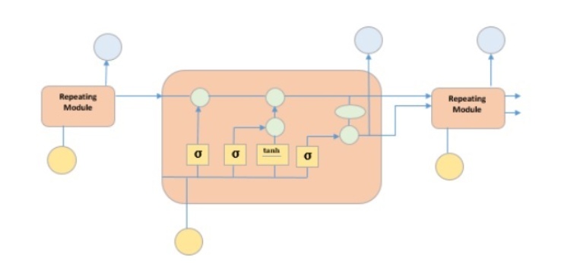
LSTMs have three types of gates: input gates, forget gates and output gates.
The hidden layer output of LSTM includes the hidden state and the memory cell. Only the hidden state is passed into the output layer.
LSTMs can help when other models exhibit vanishing and exploding gradients.

Slide 10
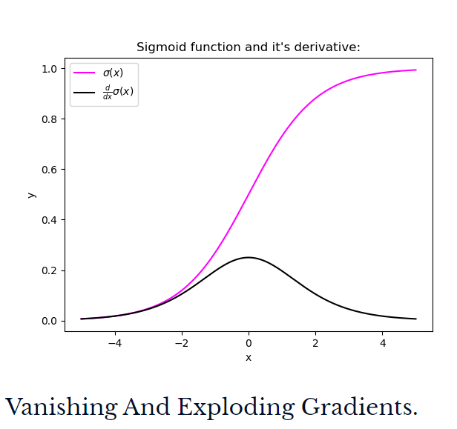
Exploding and Vanishing Gradients
Exploding gradient
The gradient associated with each weight in the network is equal to a product of many numbers. If this is a product of values greater than one it may cause the gradients to become extremely large.
Vanishing gradient
The maximum value of the Sigmoid activation function is less than one. Therefore, the gradients of the weights in the lower layers will contain products of many numbers less than one. As a result of this the size of the gradients associated with the weights in the lower layers become very small.

Slide 11
What types of data are ideal for LSTMs
LSTM is a type of Recurrent Neural Network in Deep Learning that has been specifically developed for the use of handling sequential prediction problems. For example:
Weather Forecasting
Stock Market Prediction
Product Recommendation
Text/Image/Handwriting Generation
Text Translation

Slide 12
Data Set
Taken from kaggle https://www.kaggle.com/sudalairajkumar/cryptocurrencypricehistory?select=coin_Bitcoin.csv
Selecting cryptocurrencies to analyze
Scraping process
Cleaning process

Slide 13
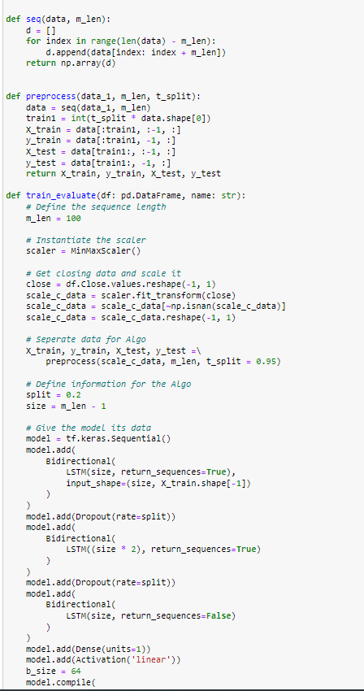
Splitting, Training, Scaling the LSTM Model

Slide 14
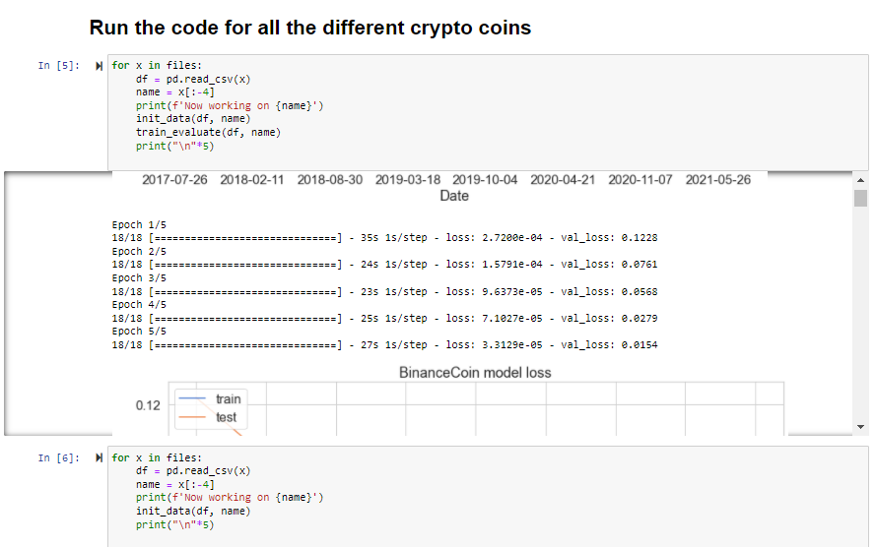
Looping Through All the Data

Slide 15
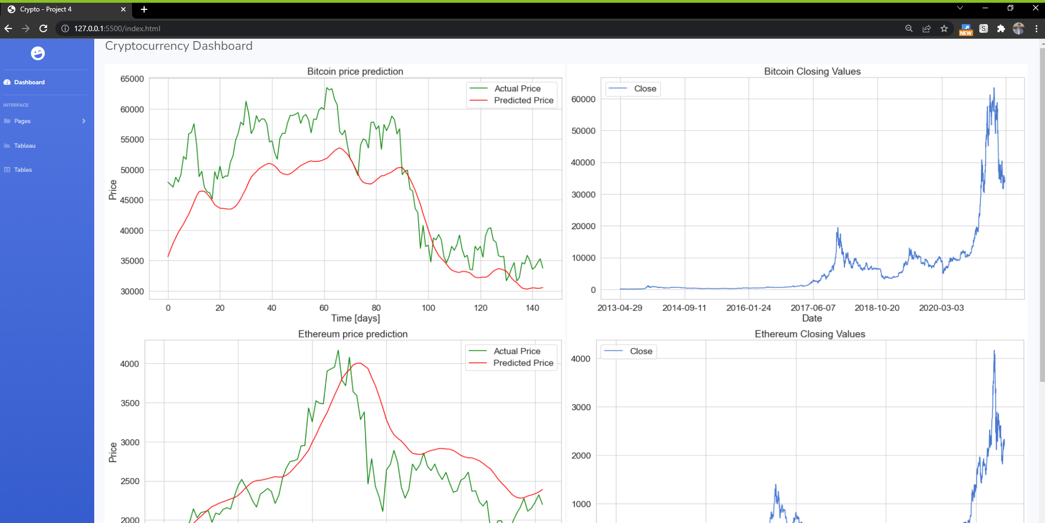
Deployment of Visualizations to HTML

Slide 16

Q & A

Slide 17


Exit

